Slide 1

Maze Challenge 2.0
GenCyber 2023

Slide 2
Sphero Maze Challenge
Objectives:
-Learn how a new technology works by tinkering with it.
-Use block code to create a program for Sphero
-Use trial and error to measure time and speed needed to create a successful algorithm for autonomous navigation through the maze
Overview: This activity is all about getting Sphero through a maze via precise programming. Getting Sphero up and running and then developing this program will involve lots of test runs and failures. While the basic activity may be intriguing, the real exploration comes in the various challenges that can be d frustration should be encouraged to try new things, cto customize tadded he experience. Students experiencing difficulty anonsult resources and fellow students rather than given quick answers.
Vocabulary:
Tinker: Play with or handle an object. Motivated by curiosity.
Algorithm: A process or set of rules to be followed in calculations or other problem-solving operations, especially by a computer.
Autonomous: Action on its own, without intervention.

Slide 3
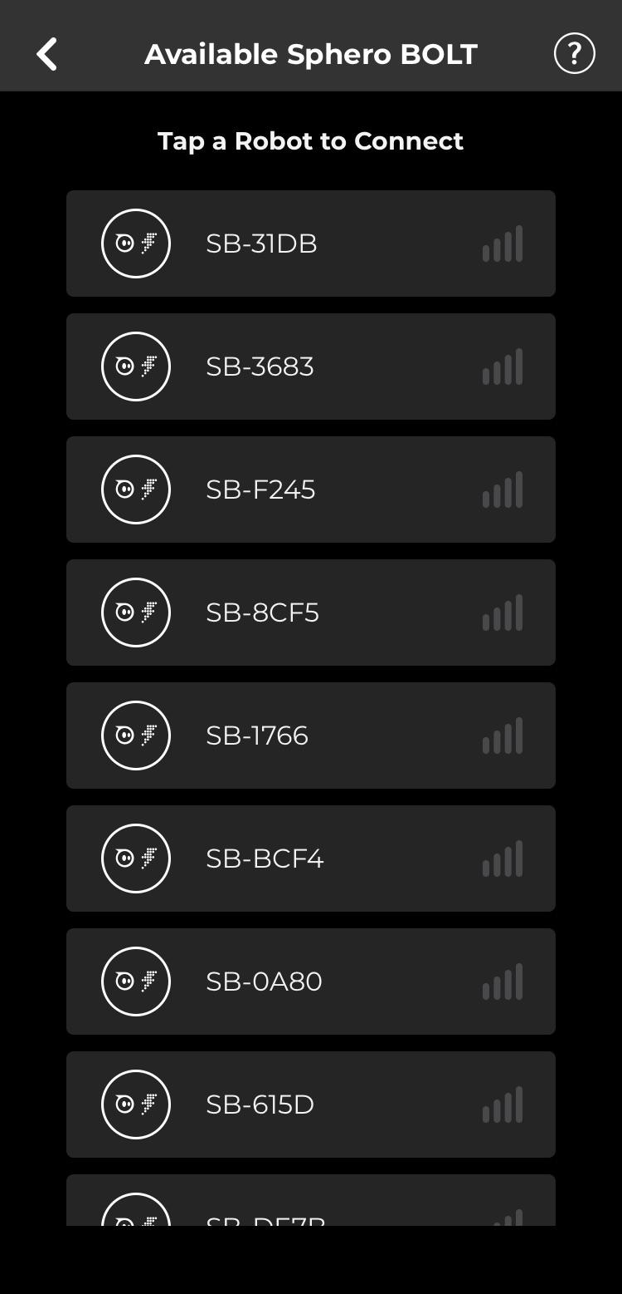
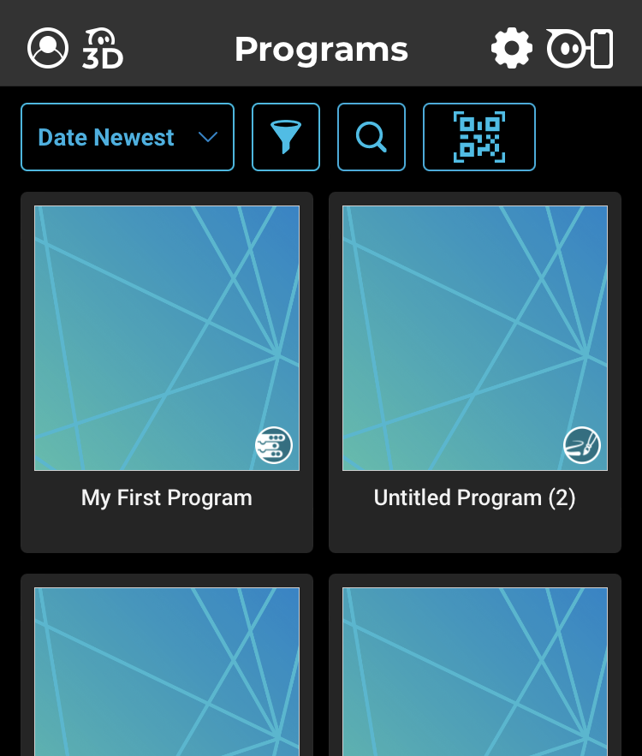
Getting Started: Connect your device
Choose your sphero from the menu
Click here

Slide 4
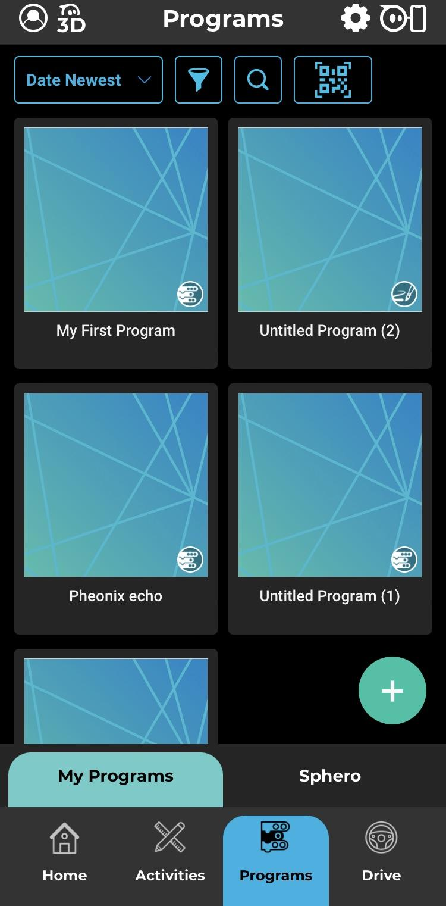
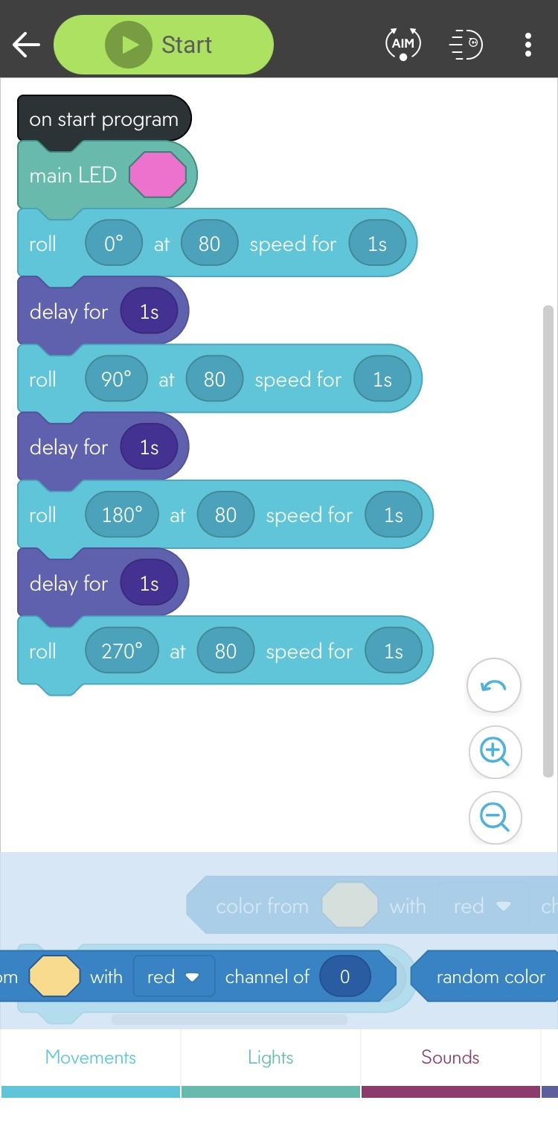
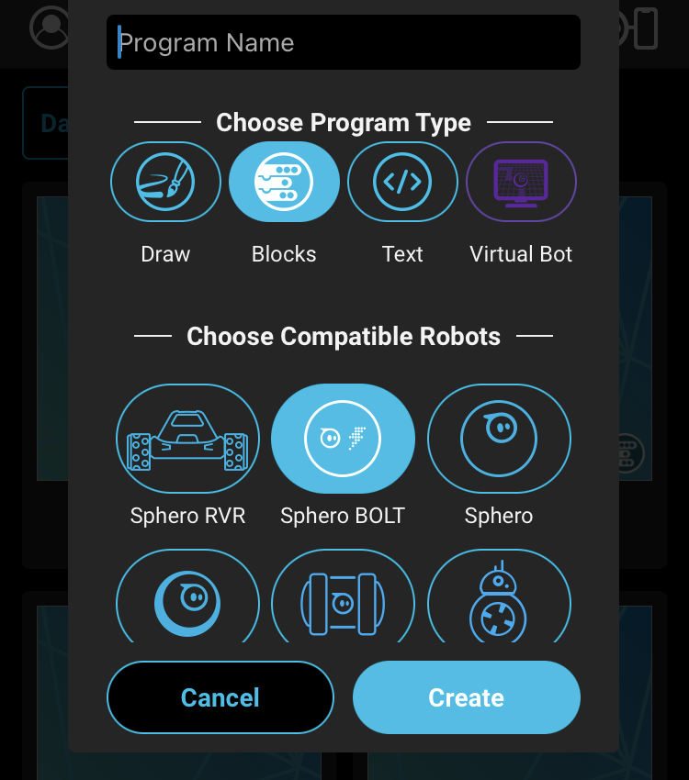
Getting Started: Creating a program
Create your algorithm!
3. Give it a name
4. choose blocks and BOLT
1. Click on programs
2. Click +
Aim your sphero before each test run for accurate results!

Slide 5
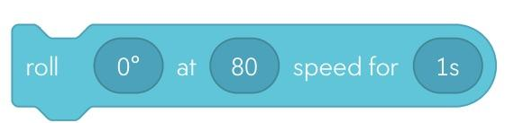
Suggestions for getting started
-A speed of 30 is a good setting to start with for your maze trials
-Sphero thinks about direction using a 360 degree circle where 0 degrees is “forward”. Tap on the “set heading” bubble in the “roll” block to familiarize yourself with how Sphero thinks about direction
- “Aim” your Sphero before each new trial,
especially if you picked it up and
carried it back to the start.

Slide 6
Challenge Instructions
-Create a maze using the tiles given to you
-Connect Sphero Bolt to tablet with bluetooth
-Open a new block code program in Sphero Edu
-Create a program in Sphero Edu and test it on Sphero
-Calibrate Sphero using the “Aim” setting in Sphero Edu
-Test and iterate to create an autonomous program to navigate Sphero from Start to Finish
Your counselors will help you level up with additional challenges to customize
your maze!

